Slide 1
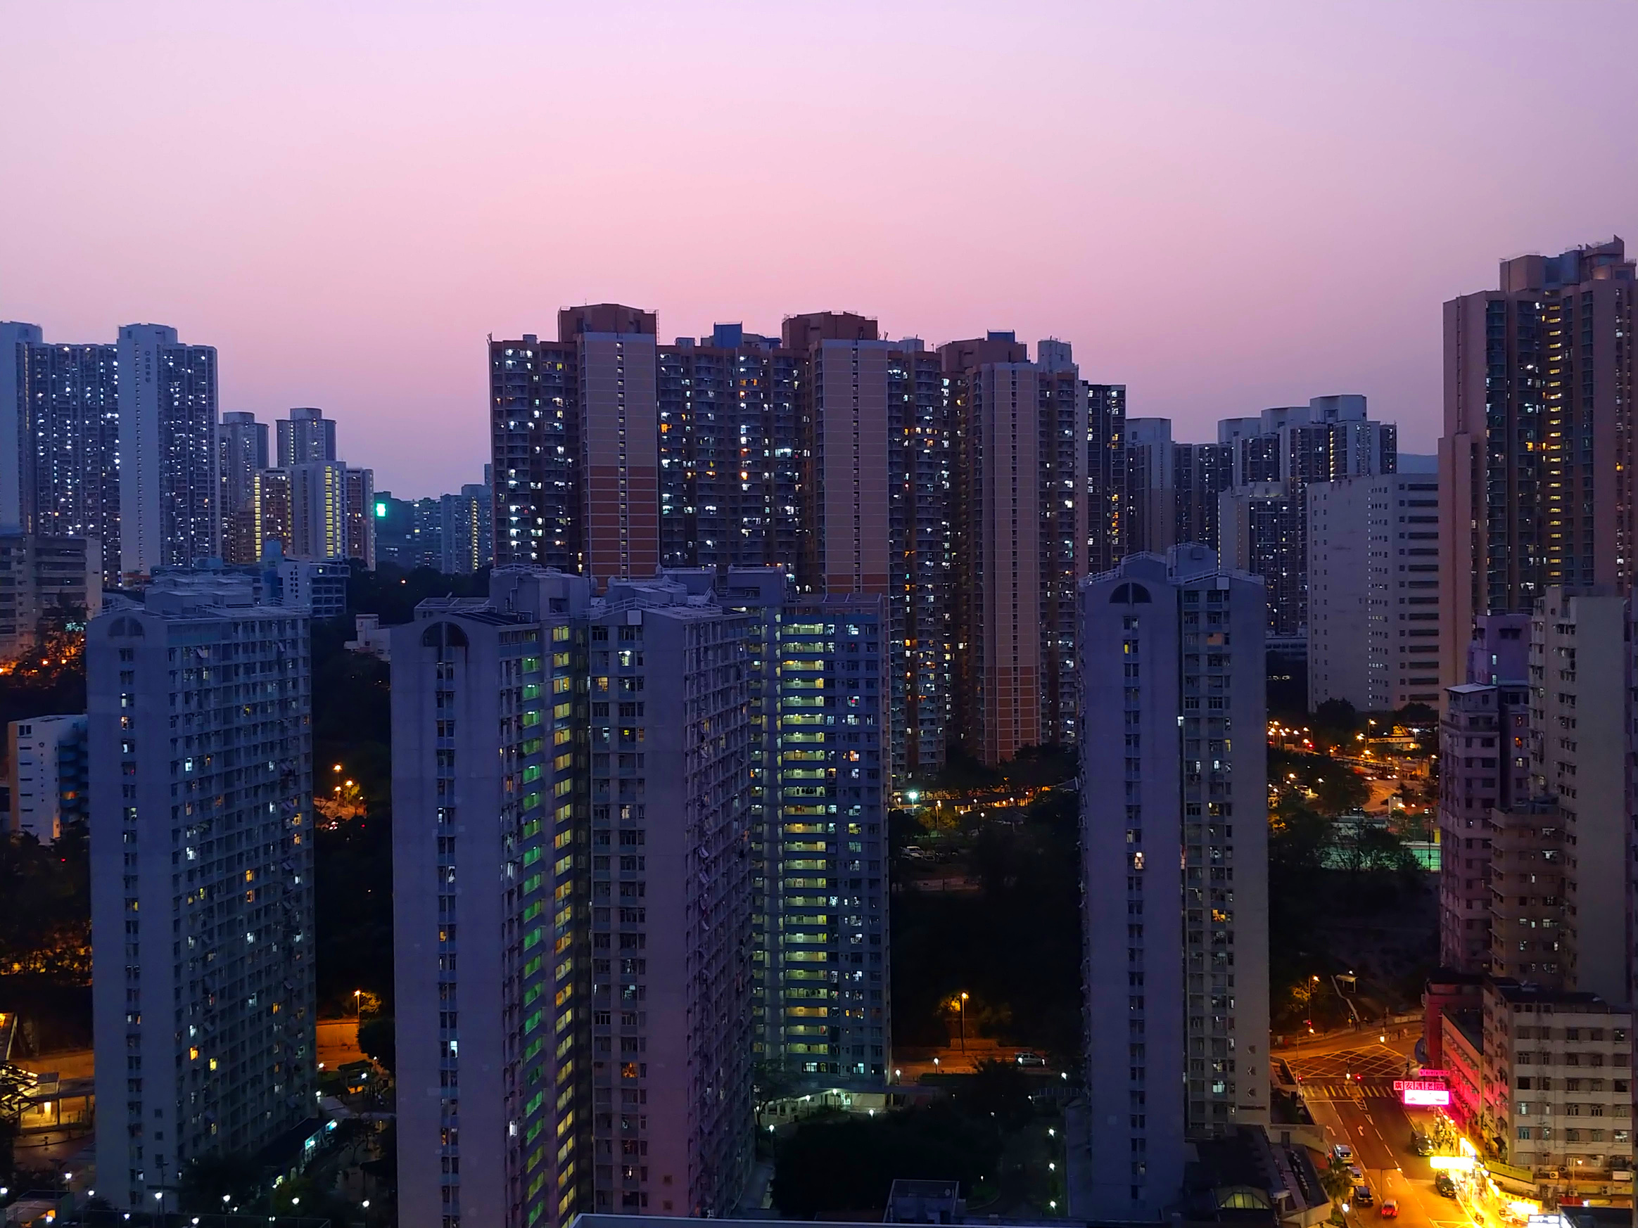
Zomato Order & Restaurant Analysis
Using Power BI

Slide 2
Over view
Number of restaurants per city
06
Revenue by area using a Tree map
01
02
Percentage(%) of orders from different cities
07
Order density by city using Heat map
03
Order amount trends over time
08
KPI cards
04
Correlation of factors affecting average rating
09
Sales Summary
05
Top 5 restaurants by total sales
10
Power BI Dashboard

Slide 3
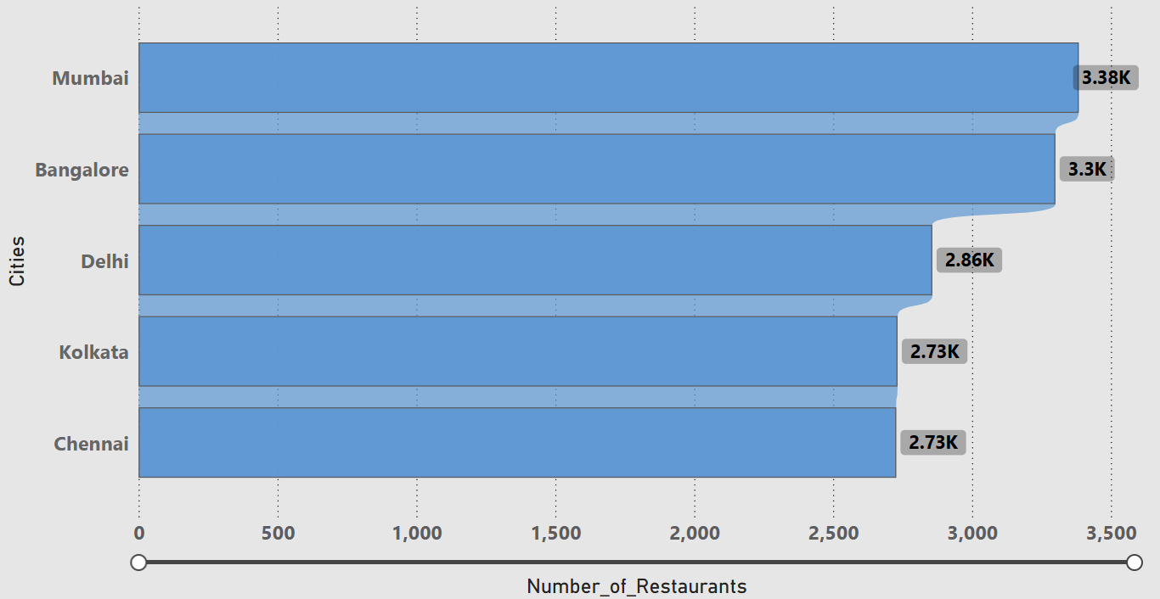
Number of Restaurants per city
Mumbai (3,384) and Bangalore (3,300) had the highest restaurant presence, indicating strong restaurant density areas .
Kolkata and Chennai had the lowest restaurant count.

Slide 4

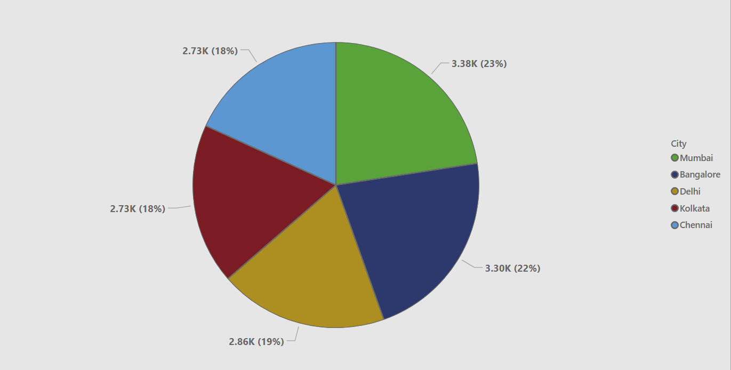
Percentage of orders by city
From the pie chart , Mumbai contributes the largest share of Zomato orders 23% .
Chennai and Kolkata have comparatively fewer orders, indicating lower customer demand or fewer active restaurants.

Slide 5
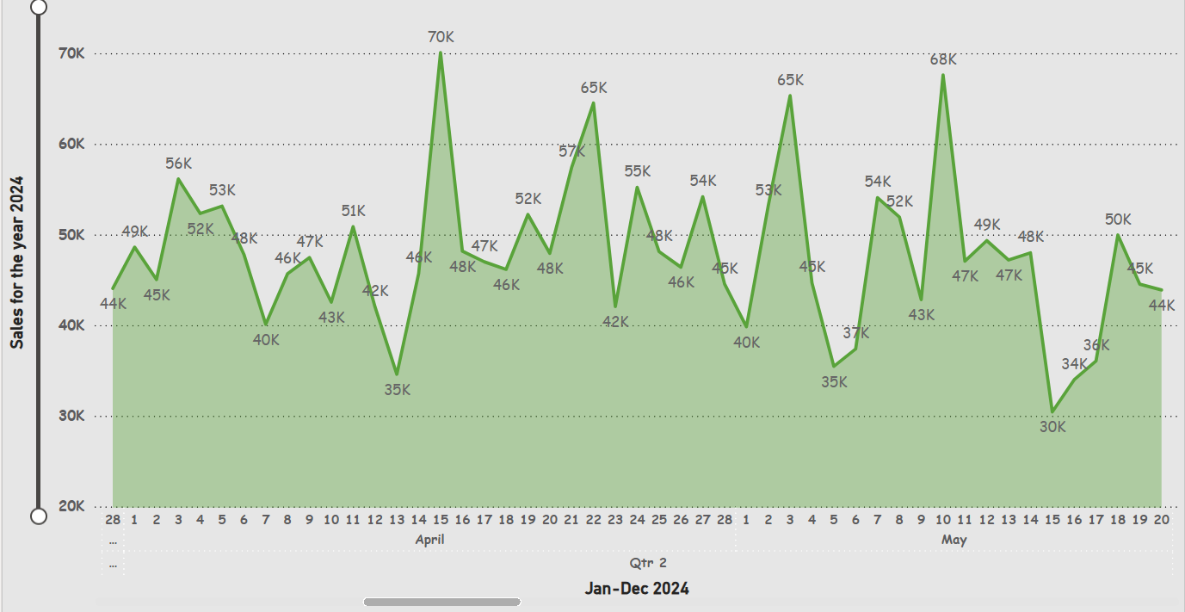
Order amount trends over time
02
01
03
Therefore , the peak sales period happened in the month of April 2024 with a sale of Rs .13,76,141
Q2
Q3
Highest volume of orders occurred on April 15th 2024 , with an amount of Rs.70,065
Lowest volume of orders occurred on Sept 4th 2024, with an amount of Rs.21,426

Slide 6
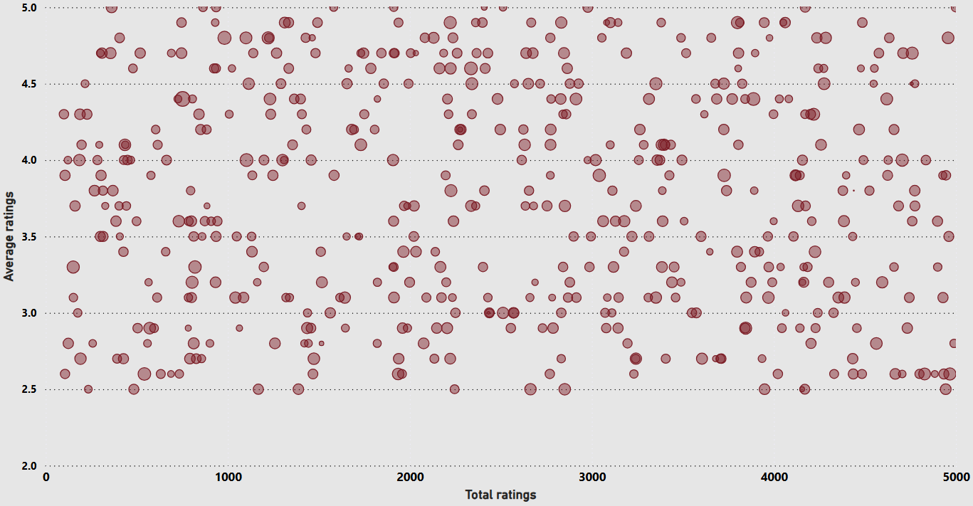
Correlation of factors affecting average rating
The average ratings(Y-axis) lies mostly between 3 to 4.5 . Few below 2.5 or above 4.8
This means even if a restaurant has a lot of ratings (popularity), it doesn’t necessarily mean its average rating is higher
This suggests that the quantity of ratings does not significantly impact customer satisfaction levels. Most restaurants maintain average ratings between 3.5 and 4.5, indicating consistent customer experiences across the platform.

Slide 7

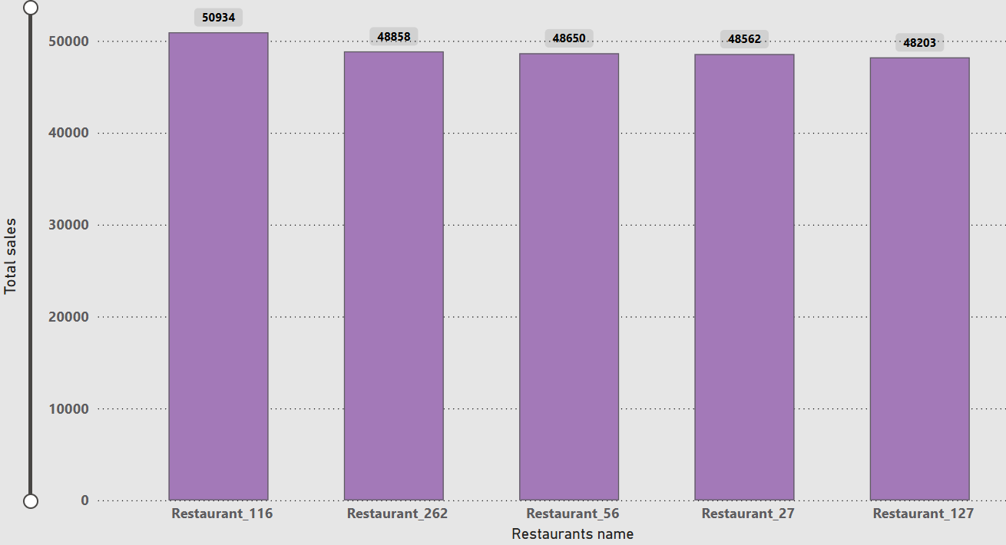

Top 5 restaurants by sales
Top 5
Restaurant_116 Restaurant_262 Restaurant_56
Restaurant_27 Restaurant_127
Total Sales
2,45,207
Restaurant_116, Restaurant_262, Restaurant_56 , Restaurant _27 , Restaurant_127 emerge as the top 5 revenue-generating restaurants, with total sales exceeding ₹48000

Slide 8
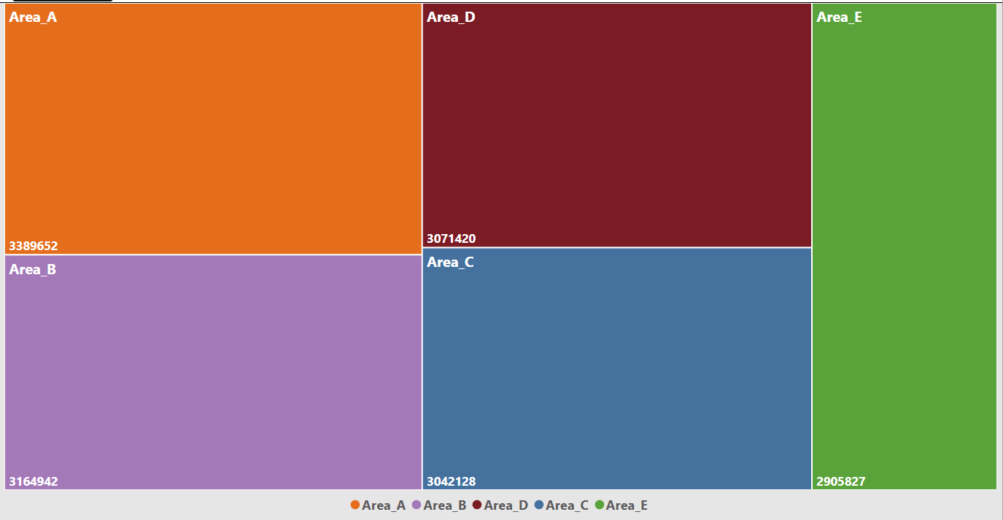
Revenue by area
The tree map clearly highlights “ Area A “as the highest revenue generating locality. This indicates strong customer demand, more orders, or higher-priced restaurants.
Areas such as “ Area C “and “Area E” appear significantly smaller in the tree map, showing lower revenue contribution. This could be due to fewer restaurants, fewer customers, or low order value.

Slide 9
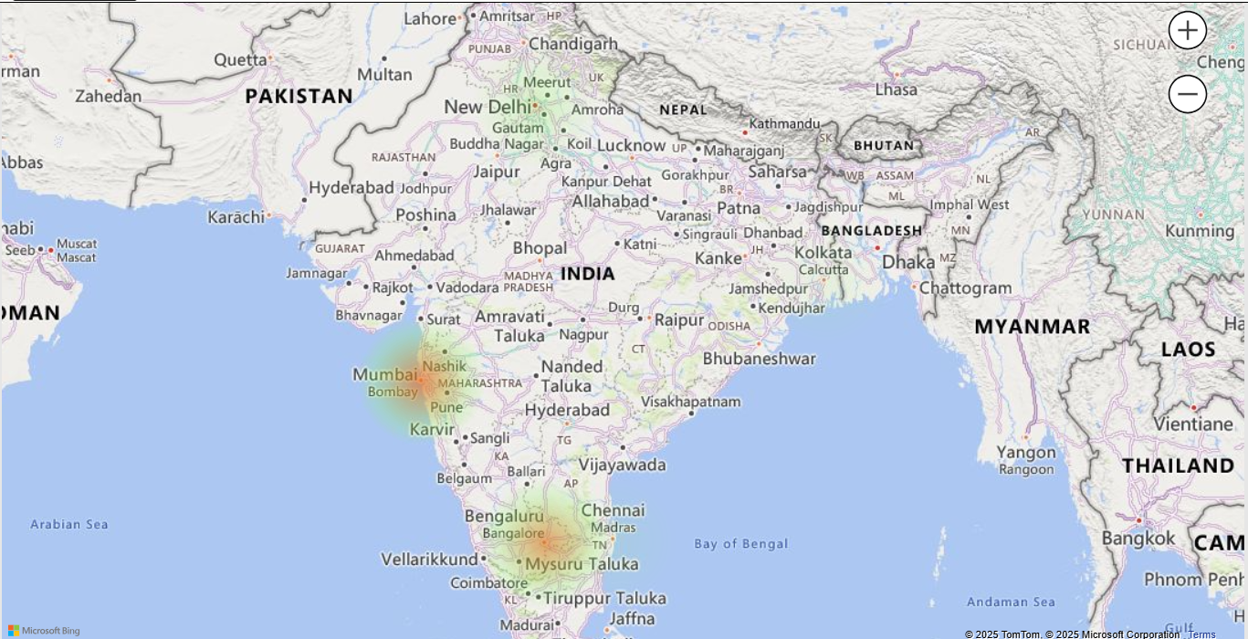
Order Density by city
Mumbai & Bangalore has the highest order density You can see the biggest and darkest bubble in Mumbai & Bangalore this means most orders are coming from Mumbai & Bangalore compared to all other cities
Chennai & Kolkata have the lowest order density The smallest bubbles are in Kolkata and Chennai, meaning very few orders come from these cities.

Slide 10
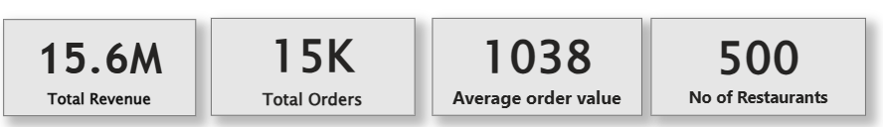


KPI CARDS – Total revenue & Average order value
A total revenue of 1,55,73,969 , indicating the overall sales performance during the selected period.
The AOV of ₹ 1,038 tells how much a customer spends on average per order.

Slide 11
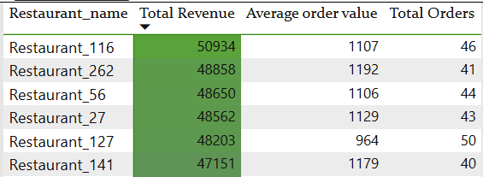
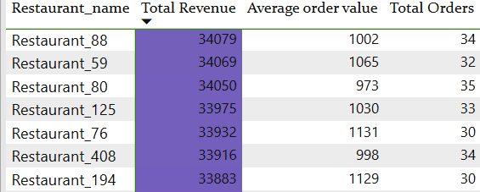
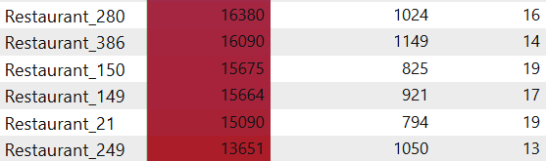
Restaurant wise sales summary
Restaurants highlighted in green represent the top performers with the highest total sales and strong customer demand.
Restaurants marked in violet fall under the average or mid-performing category.
They show moderate sales and stable order volumes, but still have room for improvement
Restaurants colored in red indicate the lowest sales and lowest order counts.
These locations require immediate attention, as they contribute the least to overall revenue.

Slide 12
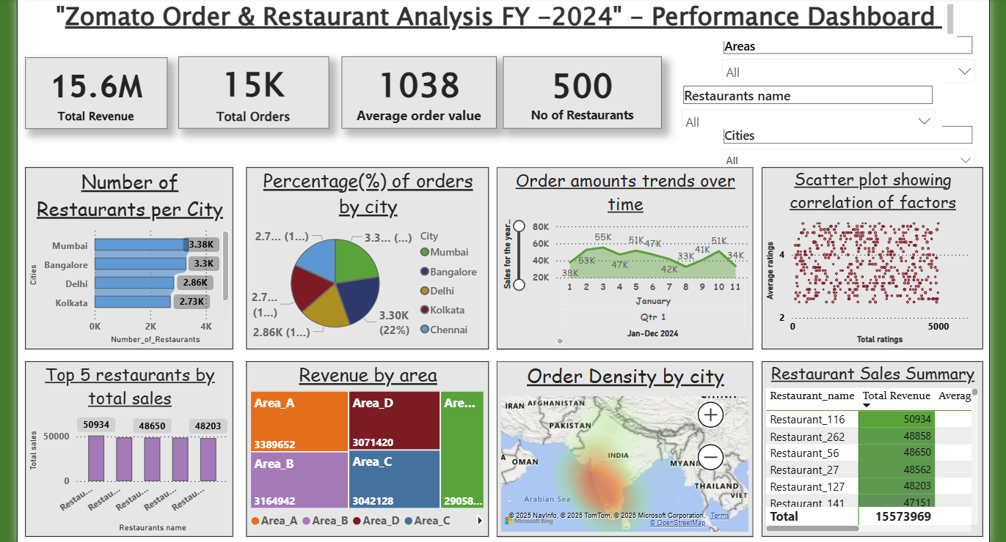
Power BI Dashboard
From the dashboard, we can see that most orders are coming mainly from big cities like Mumbai and Bangalore, while cities like Chennai and Kolkata have comparatively fewer orders. The order trend over the months is not constant .Some months show higher ordering, and some months show a drop. We also notice that only a small number of restaurants make very high sales, while many others perform at an average level. This shows that customer demand is stronger in certain cities and concentrated among a few top restaurants.

Slide 13

Thank you for listening!

